Slide 1

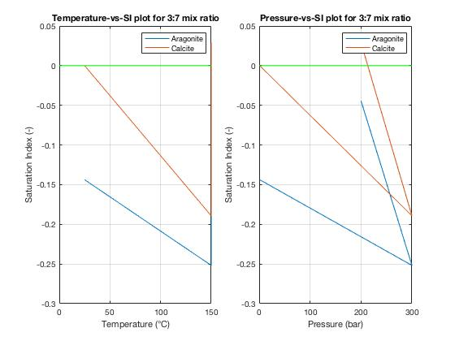
Effect of Mineral Scaling on Geothermal Wells
Omschrijving van het eindwerk:
[Scaling is one of the major challenges faced in geothermal wells which often leads to lower production drive for the geothermal energy. This report explains the effect and how it occurs]
[Ullas Rajvanshi]
[4429605]
My result:
Scaling is a highly sensitive process. If kinetics were to be taken into account this could lead to scaling of the wells within the first 3 weeks. Calcite precipitation was always there along with aragonite and occasionally dolomite.
Supervisors:
Dr. P. Vardon & Dr. D. Voskov
Betuwe route
Afdeling / sectie
Applied Earth Sciences

